Slide 1
Community Update
February 13, 2023
6:30 -7:30 p.m.

Slide 2
MOUNTAIN SAGE COMMUNITY SCHOOL
OUR MISSION
Mountain Sage Community School offers Waldorf-inspired, arts-integrated education, fully incorporating sustainable living practices into student learning. Each child is empowered to cultivate meaningful connections to their intellectual, physical, emotional, social and creative capacities in healthy, safe and beautiful learning environments. Through a supportive community of peers, parents and teachers, each child will become a confident, self-directed and engaged learner, invested in their own education.
OUR VISION
Mountain Sage Community School is a highly sought after school providing a rigorous educational program where a whole-child approach to learning results in student curiosity and enthusiasm, allowing each child to reach the fullest expression of their individual potential. Children emerge from Mountain Sage as intelligent, compassionate, creative thinkers, who are engaged citizens with a strong work ethic, prepared to become stewards of the earth and its many diverse communities.
By integrating traditional Waldorf methods and curriculum into the Colorado Academic Standards, children will leave Mountain Sage with a life-long passion for learning, well prepared for the transition into other academic programs.
Mountain Sage embraces the key aspects of the local sustainability movement, providing students and their families with an increased connection to their local environment. By utilizing the rich community resources of Fort Collins, and through ongoing cultivation and development of the school’s land with edible gardens, all children deepen their connection with the earth, self and community.

Slide 3
Overview
Welcome & Introductions
Board Overview
School Update
Facilities Update
Financial Update
Serving on the Board & Elections
Q&A
“Receive the children in reverence, educate them in love, and send them forth in freedom.”
— Rudolf Steiner
Notes:
(AH) -
Welcome
Thank you for being here - please share in the comments what brought you here tonight (change name if needed so we know who you are)
Intro:
My name is Ashley Haas
This is my second year on the board and my first as the Board President
My family has been a part of the school for 6 years
My son is a 6th grader and my daughter is a 3rd grader
Tonight we will be covering all of the areas that the board is involved with including how you can get involved with the school at this level.
As board members, we are all dedicated parents who have been active volunteers but wanted to deepen our commitment.
We believe in the vision and mission of the school and are dedicated to providing supporting the community and it’s long term sustainable future.
Again,
Thank you again for being here. We appreciate you so much!

Slide 4
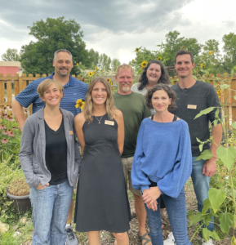
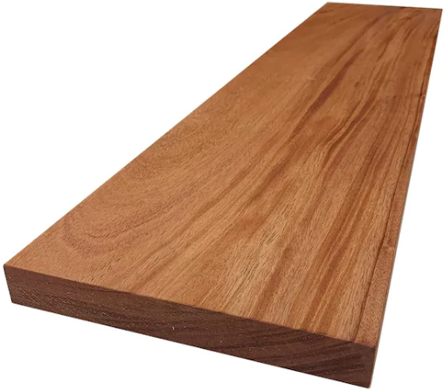
Board Overview
By Eric Richardson - 5th year on the Board, I have a son in 6th Grade & daughter in 8th.
not this one…
This one…
Notes:
ER: 3-5 minutes
Board members are people too. Lower the mystique that might keep parents from volunteering for the board.
What are the kind of things the Board focuses on and does. What is it we do at a high level. We are a governance board. Cover the big buckets on the strategic plan.
People should attend board meetings. They are open to the public.
Picture of a board seems like a requirement, and our Board

Slide 5
Board Overview
Volunteers with diverse backgrounds who love our school
Supporting a common mission and vision
Governance, not Operations
What do we do?
Meetings - Typically 1 per month during the school year plus 2 retreats each year
Colorado Sunshine Law/Open Meetings Laws = public meetings
Strategic Planning
Policies and Procedures
Budgets, Financials, Audits, and Fundraising
Facilities
School Performance & School Accountability Committee
School Director - Selecting, Supporting, & Evaluating Performance
Relationship to PSD and Charter Authorization
Recruiting and Training future Board members
Notes:
ER: 3-5 minutes
Board members are people too. Lower the mystique that might keep parents from volunteering for the board.
What are the kind of things the Board focuses on and does. What is it we do at a high level. We are a governance board. Cover the big buckets on the strategic plan.
People should attend board meetings. They are open to the public.
Picture of a board seems like a requirement, and our Board
Training includes peer training and documentation, but also training through the Colorado League of Charter Schools, the Alliance for Public Waldorf Education, and other 3rd party materials.

Slide 6
School Update
Grateful and excited to be back to the “new normal”.
10 year Anniversary - we now serve 300 students.
Recently received our second charter contract renewal with PSD. Hooray!
The next renewal is in 2028
Join us for the new Community Circle - typically occurs on the 2nd Friday morning each month from 8:30a-10:00am.
Return of community wide May Fair - stay tuned for details. We look forward to seeing you there!
Notes:
LM: ~10 Minutes
Topic Ideas
10 Year Anniversary
Academic performance & Charter Renewal
Misc…community outreach: Future surveys, festivals, volunteering
Facilities as it connects to our program, a two-track program with expanded reach into the community
After the challenging and difficult pandemic years, we are grateful to be been back to “the new normal" this school year.
We are excited to be back to the rhythm of welcoming parent volunteers, going on field trips, and engaging more freely in community. These aspects were dampened in the height of the pandemic, so these things feel like an exciting return!
This school year marks the 10th year of operation for Mountain Sage. Our school serves nearly 300 students.
We recently received our second charter contract renewal with the Poudre School District. Hooray! The next renewal will be in 2028.
This year we introduced Community Circle. Community Circle typically occurs on the second Friday morning of each month. Gatherings happening at the school from 8:30-10am.
These community education events offer inspirational and experiential education about our school’s unique program to the adults in our community.
We hope you will join us!
In other exciting news, this year will mark the return of community-wide May Faire celebrations. In the past few years, this was event held during the school day. This year will mark the return of the Saturday morning community-wide approach to this event. Stay tuned for details. We look forward to seeing you there!

Slide 7
Facilities Update
Chris West
Daughter in Annie Addington’s first grade
Son in Gail Spinden’s third grade
First year of my elected three year term
SAC - School Accountability Committee - Board Liaison
Discusses and recommends priorities for school funds, important school culture and parent partnership issues, and participates in the preparation of the school’s Unified Improvement Plan.
Facilities Chair as of October 2022
Took over Facilities Chair position from Ashley Haas the current MSCS Board President
Notes:
CW: ~5 minutes

Slide 8
10th Year of MSCS
Chartered as a two track
What is a two track school
Double classes for every grade
Current two track classes
First grade
Fourth grade
Sixth grade
No more room to grow
MSCS get funding from student count & most fund for facilities unlike PSD schools.
MSCS Salary 38K Base vs PSD Salary 48K Base
Notes:
with a 2-track program we could increase our base salaries from $38K to $46K+ in $2K increments each year until we organically reach our 2-track goal
we would stay a single-track school
-the max we could increase our base teacher salary would be $43K (PSD is currently $48K and about to increase to $50K)

Slide 9
Recap of Timeline
2021 looked at three options
Purchase current building
Buying a different building
Purchasing land for a new building
Purchased the current building in April 2022
Bond for purchase of building and expansion
Lease
Currently lease the playground and school garden land
May 2022
Vision for the new future of MSCS

Slide 10
OAC Team
Owners - MSCS Facilities Team
Liv Helmericks, Amanda Griffith, Hillary Mizia, Jon Pointer, Chris West
MSCS Operational Team - Collaboration and feedback from staff
Owners Rep - Anser Advisory
We do not know what we do not know
Architect - Ewers Architecture
Contractor - Fransen Pittman Construction
Notes:
Kurt Connolly & Kendra George
Peter Ewers & Ann Ormsby
Josh Davis, Derek LePore & Dave Eddy

Slide 11
Working Together During A Complex Project
OAC Meeting once/week with the Facilities Committee
MSCS - Liv Helmericks
Surveys and Check-in with the staff
Financial Committee
Bryan Kimbell | Board Treasurer - Finance Committee Chair
Finance Committee meets once a month
Bryan attends OAC meetings once a month or more
MSCS Board Meeting
Board of Directors Meetings - open to the public
Facilities Committee Report - once a month to all board members
Financial Committee Report - once a month to all board members
Board Works Sessions as needed
OAC Team is also attend board meetings as needed

Slide 12
Cost & Feasibility
Bond 8.8M
3.5 Million for building purchase
5.3 Million for expansion
BEST Grant
CO Department of Education Grant submitted Feb 6
Projects are awarded in June
Phase 1.5
How did we get to a 1.5 phase project?
8.2 Million - includes the remainder of the Bond and the BEST Grant
We will have more information about timeline in the summer.
Notes:
Grant Request $ 3,850,909.75
Applicant Match to this Project $ 4,342,515.25
Total All Phases $ 8,193,425

Slide 13
School Financials Update
Bryan Kimbell
2 boys at MSCS - twins in Ms Wixson’s 4th Grade class
4th year on the MSCS Board
Board Treasurer since 2020-2021 school year
Notes:
BK: ~5-10 min
Importance of student count and PPR

Slide 14
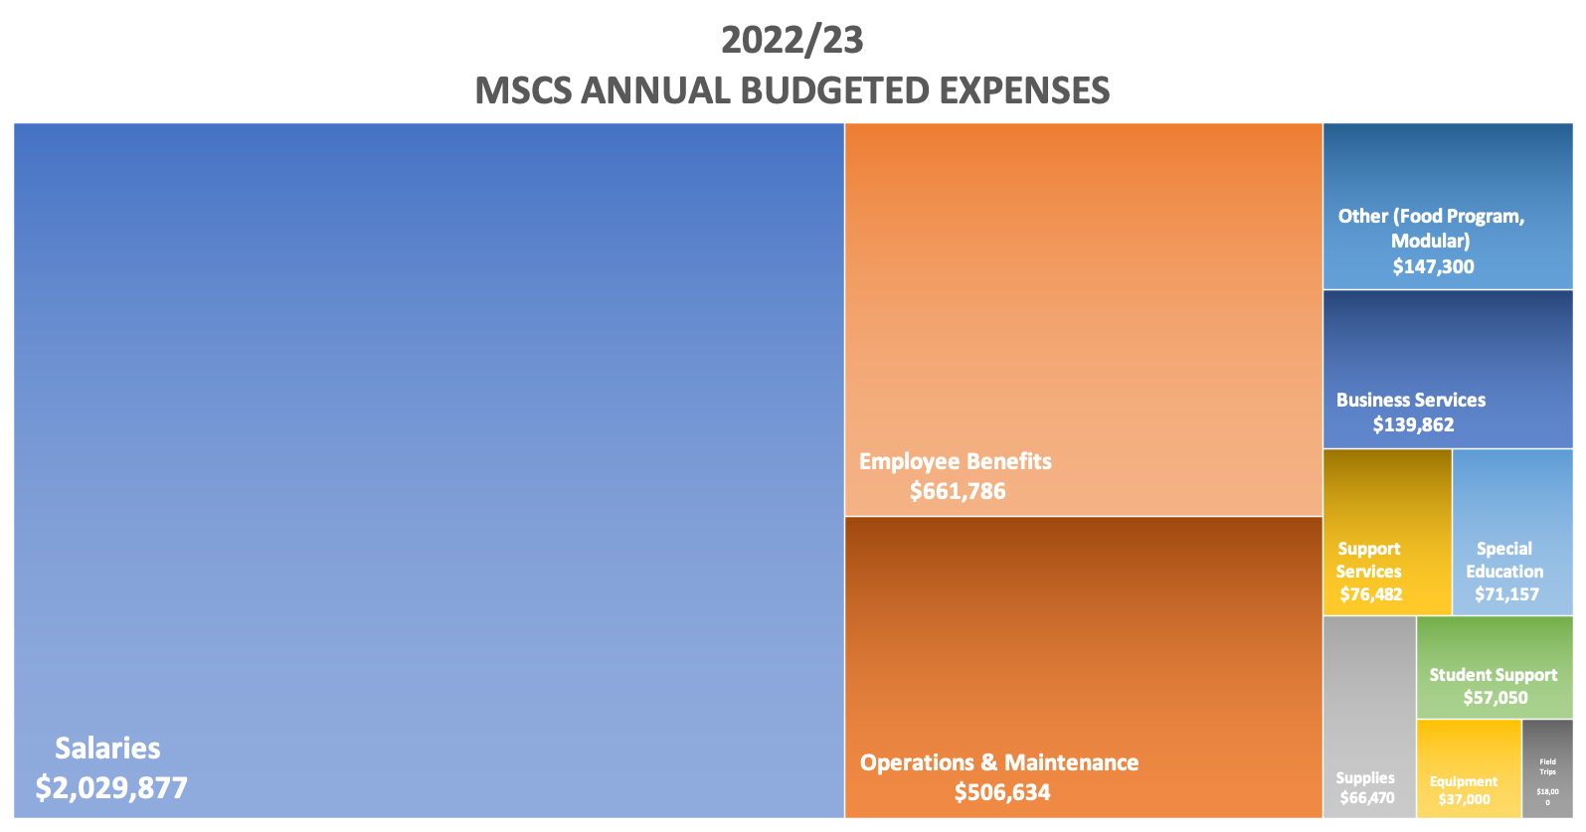
Notes:
BK: ~5-10 min
Importance of student count and PPR

Slide 15
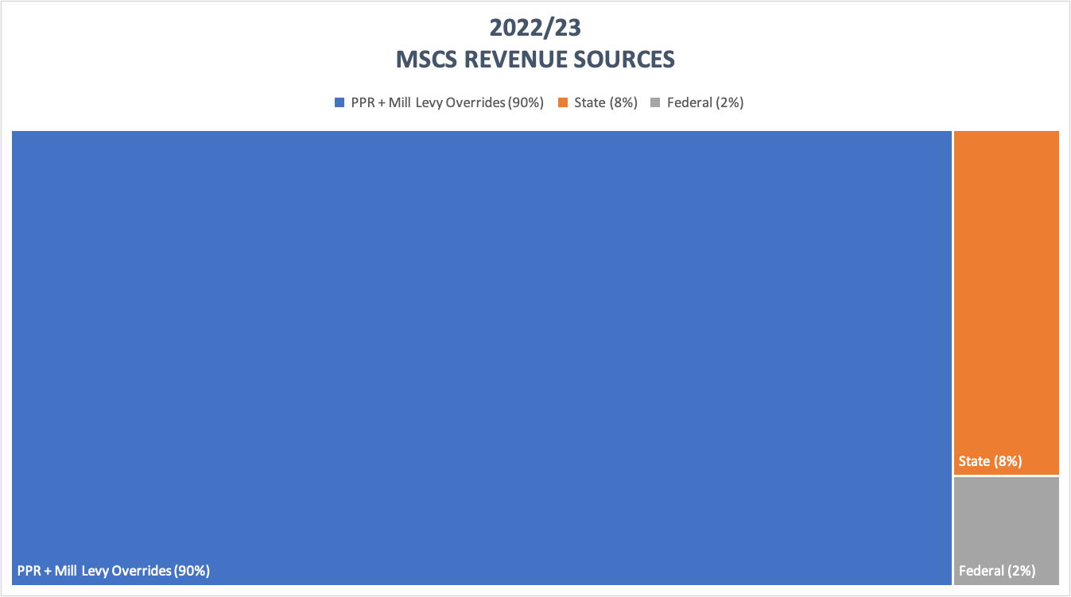
Notes:
BK: ~5-10 min
Importance of student count and PPR

Slide 16
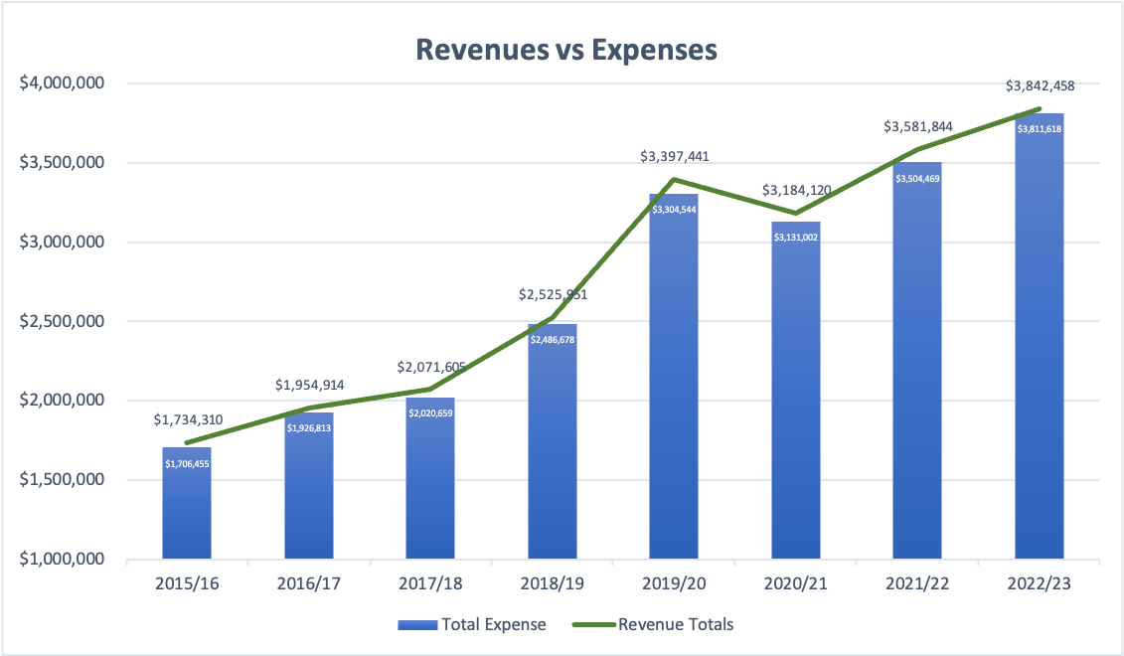
Notes:
BK: ~5-10 min
Importance of student count and PPR

Slide 17
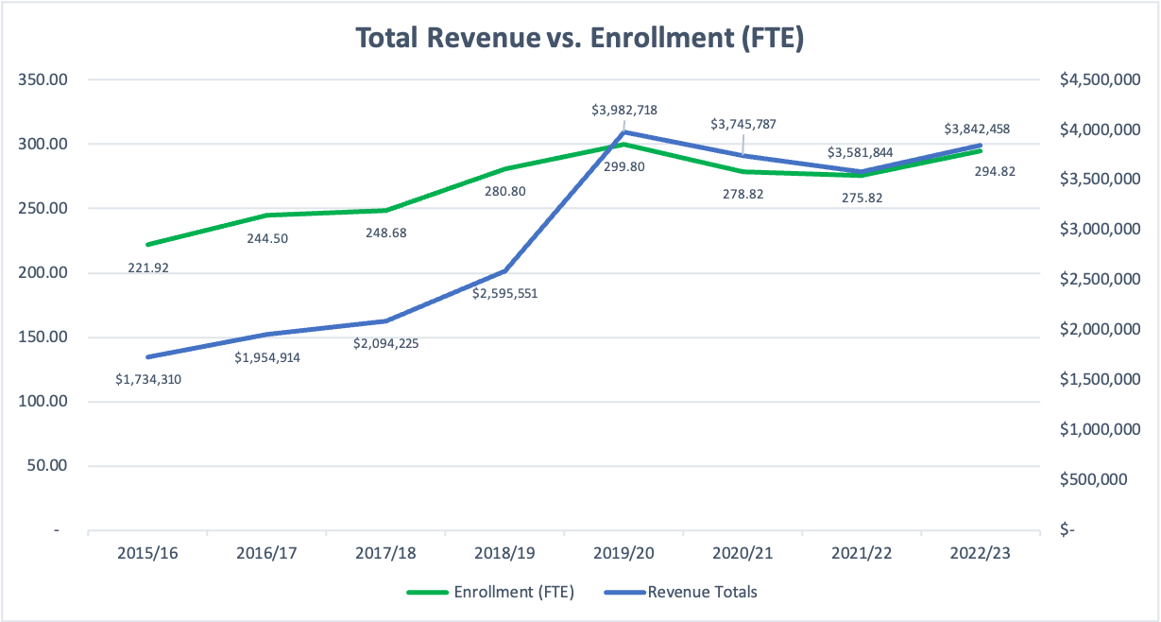
Notes:
BK: ~5-10 min
Importance of student count and PPR

Slide 18
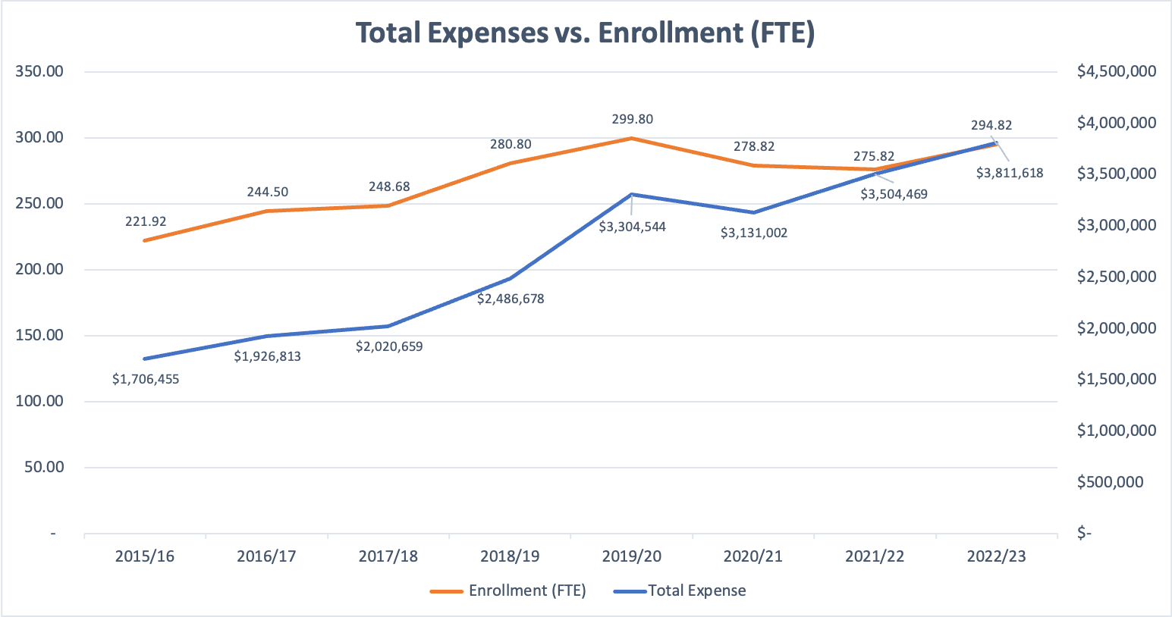
Notes:
BK: ~5-10 min
Importance of student count and PPR

Slide 19
School Financials Update - Key Takeaways
MSCS is in a strong overall financial position
Expenses will continue to go up regardless of enrollment
State funding (PPR) meets basic needs, but as a charter school it does not meet ALL of our needs
State funding does NOT extend to facilities, special programs, or student support services
MSCS needs to build student count and fundraise to continue building the Waldorf-inspired learning environment
Every student COUNTS - in more ways than one!
Notes:
BK: ~5-10 min
Importance of student count and PPR

Slide 20
Governance Committee
Rachael Sudhalter
8th Grader- Mr Van Horn
Two Charters and Two Private Schools
3rd year on the MSCS Board
Vice President and Governance Committee
Jen Rault
2 sons, 8 and 3
Lived in Fort Collins for almost 2 years
1st year on the Board
Governance Committee member
Notes:
RS & JR: ~5 minutes
Include opportunity to meet new candidates: McKenzie and Bryan
Let Board Members speak to why they joined the board
What are our needs as a Board? Facilities, Financials, Fundraising and Donor Development
Board requirements- attend 3 meetings prior to the April election

Slide 21
Serving On The Board & Elections
Why join the Board?
Meet our two Candidates for the April 2023 Election:
McKenzie Mushel Ellis
Has a Kindergartener at MSCS
Taught at Rocky High School
Bryan Kimbell
Current Board Treasurer - would like to serve another 3 year term
Notes:
RS & JR: ~5 minutes
Include opportunity to meet new candidates: McKenzie and Bryan
Let Board Members speak to why they joined the board
What are our needs as a Board? Facilities, Financials, Fundraising and Donor Development
Board requirements- attend 3 meetings prior to the April election

Slide 22
COME JOIN THE BOARD!!!!!!!
Requirements for joining the Board
Volunteer verified
Attend 3 board meetings
Current Board Member needs
Treasurer
Grant Writing and Donor Development
More members - we have 3 more spots
Notes:
we can have 9 elected members - we have 3 more open spots.

Slide 23
Q&A
Notes:
SP (Questions):
AH -
Before we start, I’d like to share the board’s gratitude to our teachers and staff. We know that the work you do with our children is shaping them into amazing humans and we appreciate you. The work you do does not go unnoticed!
If you appreciate what your teachers and special teachers are doing, let them know!
They give their ALL each and every day to support your child and they love to hear even a simple “Thank You”!
We will take questions as they come in and also any that may have been submitted ahead of time. If we are not able to get to all questions we will follow up via email at a later date.

Slide 24
Thank You Mountain Sage Community!

